Slide 1

IBM Data Analyst Capstone Project
CHERRY MAUNG
22ND JANUARY, 2026

Slide 2



OUTLINE
Executive Summary
Introduction
Methodology
Results
Visualization – Charts
Dashboard
Discussion
Findings & Implications
Conclusion
Appendix

Slide 3

EXECUTIVE SUMMARY
Project Overview - This project addresses the real-world problems of employment in technology sector in terms of key features such as employment type, age, education level, technology used, future trends and satisfaction level, etc.
Objectives and Purposes –The objectives and purposes include to handle a complex, real-world dataset and produce visualized presentation for key findings:-
Most of the current language usage is the same as future trends except for PHP, PowerShell where Go, Rust in future trends will be replacing.
In Future Technology Trends, more than 2500 respondents are interested to use the framework suvelte.
More than half of the respondents are in the age group between 25-44 years old.

Slide 4

INTRODUCTION
This project use the survey dataset which include columns of employment type, work status, age, experience, satisfaction level, compensation and technologies usage and future trends, etc. It is a huge and complex dataset.
Its purpose is to evaluate current technology usage with future trends.
This report is targeted for professionals exploring career-defining competencies within the technology industry..
It provides the opportunity of enhancing skills in the process of data analysis from web scrapping, data wrangling, EDA, visualization and presentations.
The value is to acknowledge the future trends in technology sector which could improve related skillsets for future career.
The Reports in this projects include:-
Current Technology Usage
Future Technology Trends
Demographics

Slide 5

METHODOLOGY
In this project, The data set used in this assignment is the Stack Overflow Developer Survey data is available at: https://cf-courses-data.s3.us.cloud-object-storage.appdomain.cloud/HLOosvsPgIwt5dgOOh1RSg/survey-data-updated.csv
It is downloaded and loaded to the workplace using
df = pd.read_csv('survey_data_updated.csv’).
Then, exploring the dataset, identify column name, shape, data types and summary statistics.
Then, perform data wrangling by
identifying and removing duplicates,
Identifying, filling, replacing missing values with mean and frequency values or removing missing values
Standardizing the data with normalization, mapping and replacing
After that, Exploratory Data Analysis take place to identify and analyze the trends and pattern of the data. Furthermore, Matplotlib and Seaborn libraries are employed to visualize the date
Moreover, optimized data visualization dashboards with Google Looker Studio. Finally, the data is presented by using power point to communicate with the audience.

Slide 6
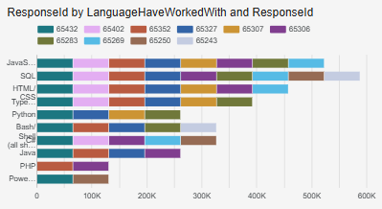
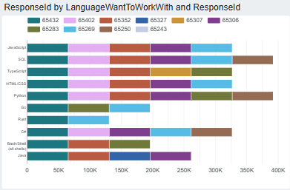
PROGRAMMING LANGUAGE TRENDS
Current Year
Next Year

Slide 7
PROGRAMMING LANGUAGE TRENDS - FINDINGS & IMPLICATIONS
Findings
SQL is the most popular language in both current and future trend.
SQL and Python are the most popular in future with 400K of respondent want to work with.
Current technology, PHP and PowerShell are the least popular language with 100 K
Implications
The language of SQL dominate current and future technology area.
Python also plays crucial role in future trends.
PHP and PowerShell of current technology usage will be replacing Go and Rust language in the future.

Slide 8
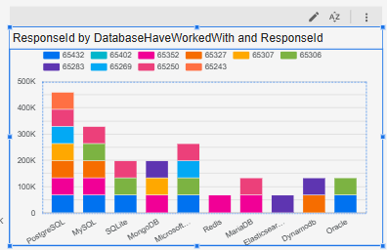
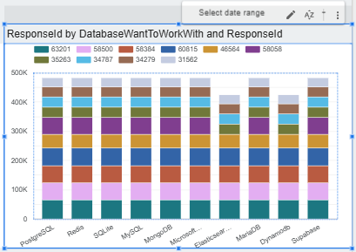
DATABASE TRENDS
Current Year
Next Year

Slide 9
DATABASE TRENDS - FINDINGS & IMPLICATIONS
Findings
PostgreSQL Database reach max 450 K respondents in current usage
Redis and Elasticsearch are the least favourable databases with below 100K current usage respectively
MySQL is the second most popular dabase with over 300K respondent currently
Implications
In the future, different types of databases will be used widely
The oracle database will be replaced with Supabase.
Elasticsearch and Dynamodb will be the least famous in future trend.

Slide 10

DASHBOARD
<Please present your dashboard in the following slides.>

Slide 11
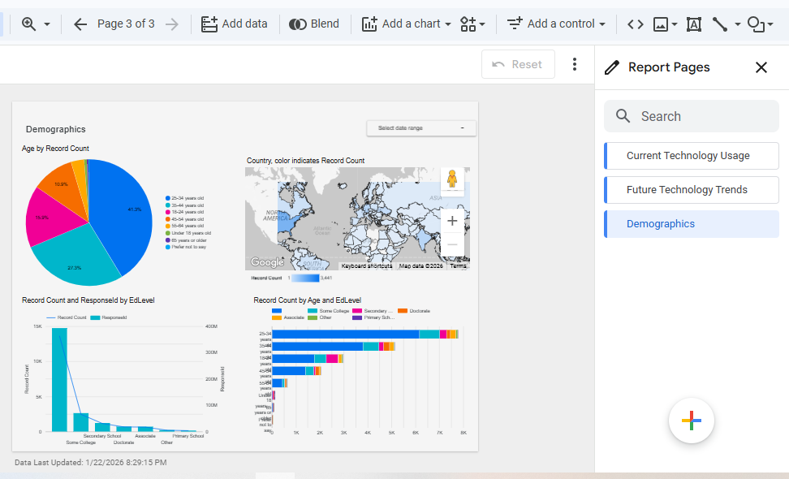
DASHBOARD

Slide 12
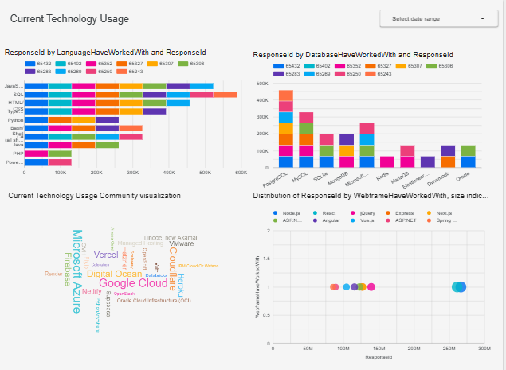
DASHBOARD TAB 1

Slide 13
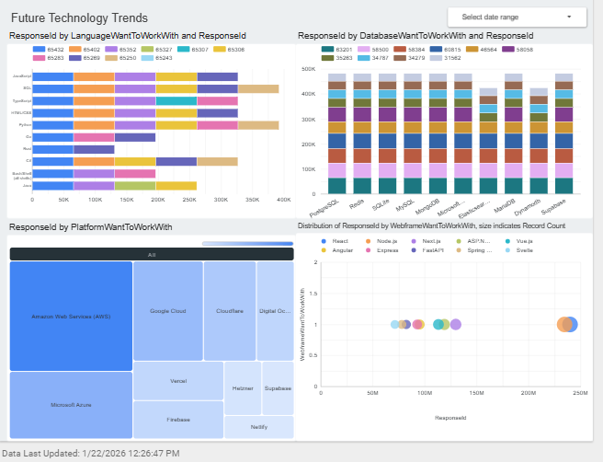
DASHBOARD TAB 2

Slide 14
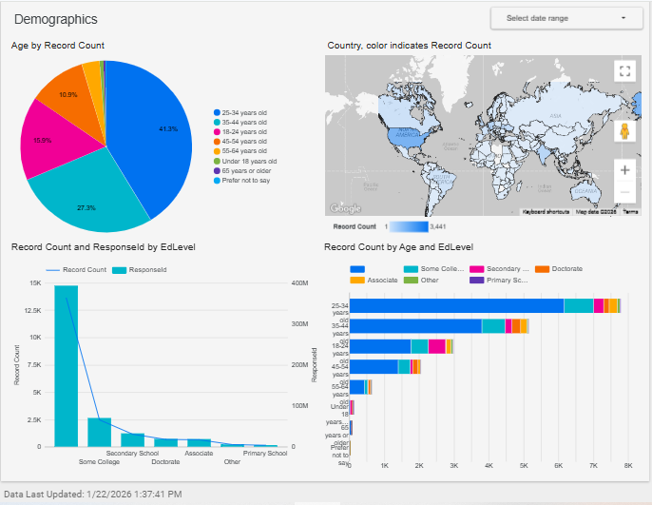
DASHBOARD TAB 3

Slide 15
DISCUSSION
The current popular programming languages, databases, web framework and platform can be visualized and interpreted from the Current Technology Usage.
The future trend of programming languages, databases, web framework and platform can be translated from the data visualization of Future Technology Trend Dashboard.
The Demographics Dashboard presents the demographics properties of respondents.

Slide 16
OVERALL FINDINGS & IMPLICATIONS
Findings
The most respondent age group is 25-34 years old approximately 41%
The Education of highest number of respondents are from college, about 15K
The intensity of respondents by country is USA around 3500 in number
Implications
Most of the respondents are :-
Young Adults
College Students
From USA

Slide 17

CONCLUSION
According to the demographics of Dashboard, most of the respondents are young-adults college student from USA.
Although there is no visible change in current usage and future trend of programming language, SQL and Python are still robust and crucial languages in the future trend.
It is clearly seen that there will be more dynamic usage in databases in the future.
AWS platform will be more popular than current Google Cloud and Microsoft Azure usage.

Slide 18
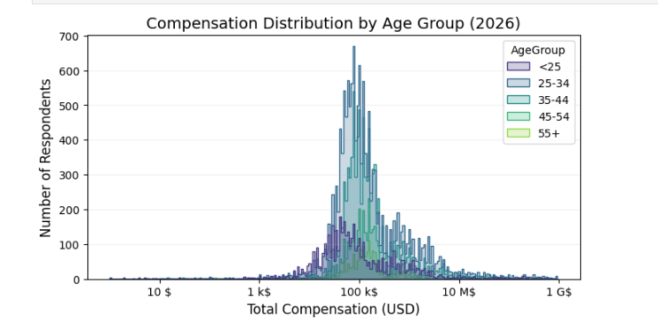

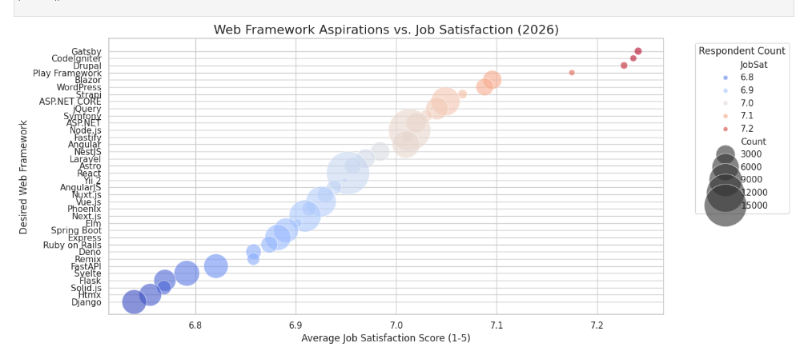
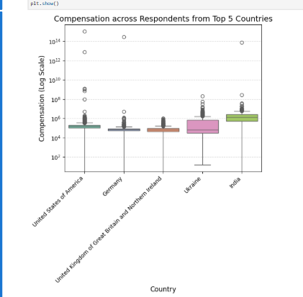
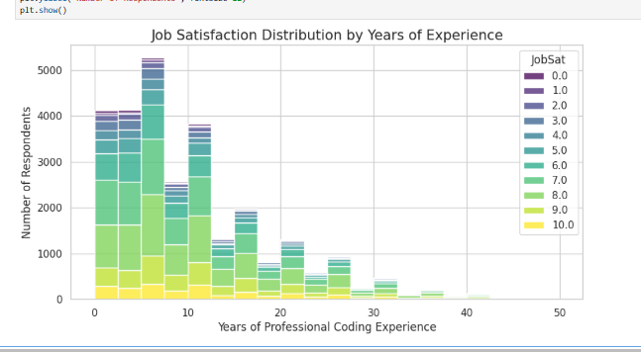
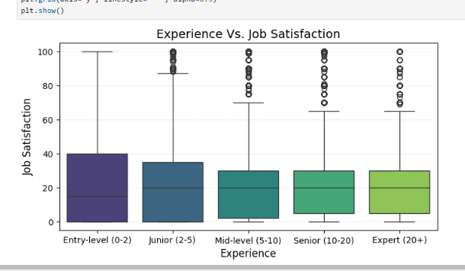
APPENDIX

Slide 19
JOB POSTINGS
In Module 1 you have collected the job posting data using Job API in a file named “job-postings.xlsx”. Present that data using a bar chart here. Order the bar chart in the descending order of the number of job postings.

Slide 20
POPULAR LANGUAGES
In Module 1 you have collected the job postings data using web scraping in a file named “popular-languages.csv”. Present that data using a bar chart here. Order the bar chart in the descending order of salary.

